Slide 1
Web Programming
*절.대.웹.프.해-Class#1, Team#10, Korea
Copyright ⓒ Slug. All right reserved.

Slide 2
01
Introduction
Topic Selection
Distribution
02
PLAYERUNKNOWN’S BATTLEGROUNDS
Composition
Source Code – css
Contents
Study
Source Code – html
Source Code – js
Web Design
03
StarCraft
About the Starcraft Website
Website Design
Code
04
League of Legends
Website Composition
Information in Website
What code was used to make contents
Website Design
Copyright ⓒ Slug. All right reserved.

Slide 3
01
Introduction
Topic Selection
Distribution
Copyright ⓒ Slug. All right reserved.

Slide 4
01
Introduction
Topic Selection
Distribution
Common Ground
1
2
3
4
Programming
Playing Games
Food
Etc…
We do Programming everyday
We play games while we rest
Like food
Not much in common
Copyright ⓒ Slug. All right reserved.

Slide 5
01
Introduction
Topic Selection
Distribution
Distribution – by topic
PLAYERUNKNOWN’S BATTLEGROUNDS
18011588 Ha Seungwon
StarCraft
PLAYERUNKNOWN’S BATTLEGROUNDS
StarCraft
League of Legends
13011133 Kim Muyoung
Kim Muyoung
Cha Seongkyu
Ha Seungwon
League of Legends
1801550 Cha Seongkyu
Copyright ⓒ Slug. All right reserved.

Slide 6
02
PLAYERUNKNOWN’S BATTLEGROUNDS
Composition
Design & Features
Source Cod - js
Source Cod - css
Source Cod - html
Copyright ⓒ Slug. All right reserved.

Slide 7
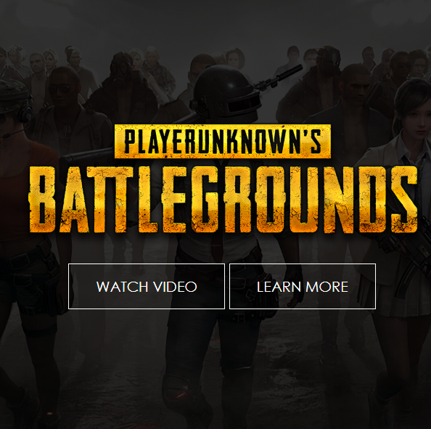
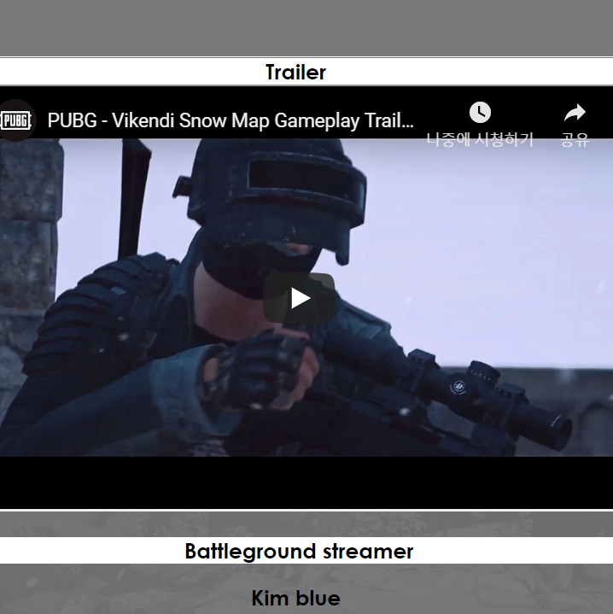
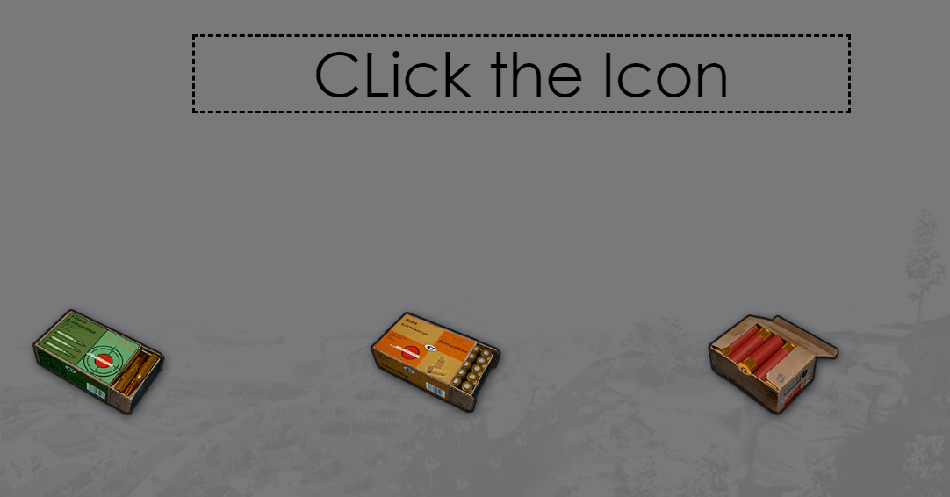
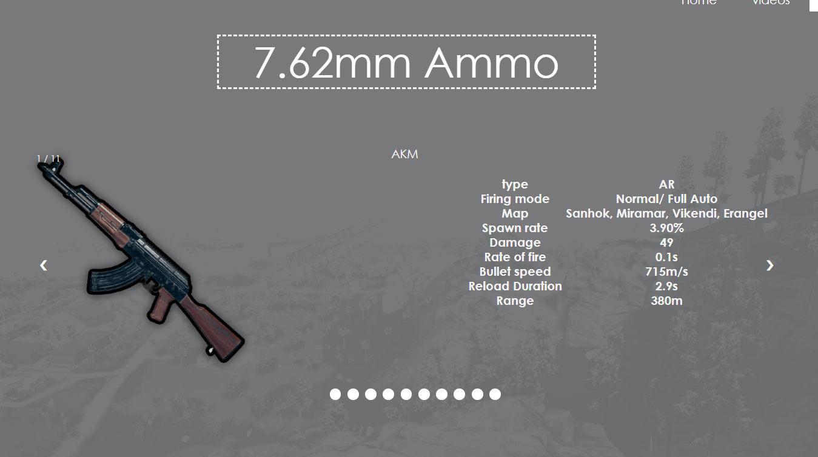
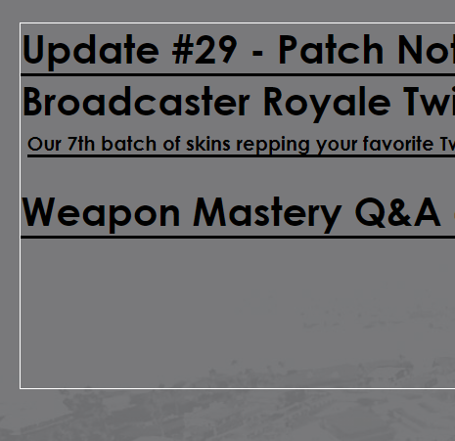
02
PLAYERUNKNOWN’S BATTLEGROUNDS
Composition
Design & Features
Source Code - js
Source Code - css
Source Code - html
The main
Videos
Information main
Information Detail
News
Copyright ⓒ Slug. All right reserved.

Slide 8
02
PLAYERUNKNOWN’S BATTLEGROUNDS
Composition
Design & Features
Source Code - js
Source Code - css
Source Code - html
Page Layout
<head> CSS script </head>
<body>
html - script
<script></script>
</body>
Features
Navigation Bar
Slide Effect
이 곳에 오른쪽 그래프와 관련한 내용을 적어주세요! 이 곳에 오른쪽 그래프와 관련한 내용을 적어주세요!
이 곳에 오른쪽 그래프와 관련한 내용을 적어주세요! 이 곳에 오른쪽 그래프와 관련한 내용을 적어주세요!
Background - transparency
Image Slide
이 곳에 오른쪽 그래프와 관련한 내용을 적어주세요! 이 곳에 오른쪽 그래프와 관련한 내용을 적어주세요!
이 곳에 오른쪽 그래프와 관련한 내용을 적어주세요! 이 곳에 오른쪽 그래프와 관련한 내용을 적어주세요!
Copyright ⓒ Slug. All right reserved.

Slide 9
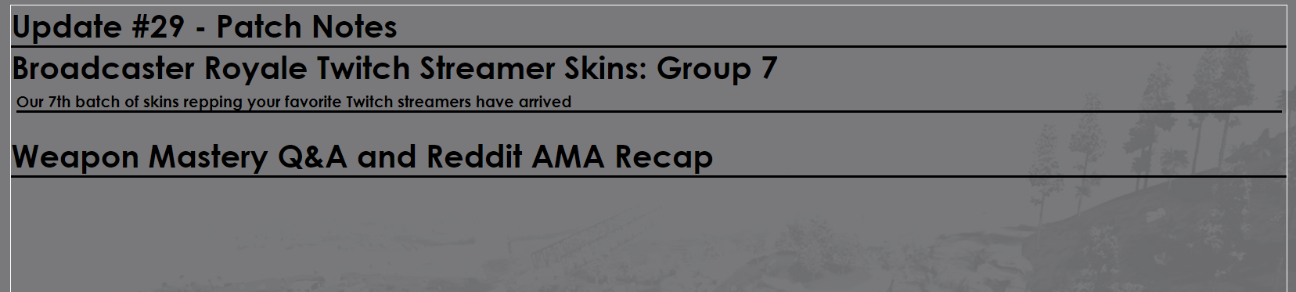
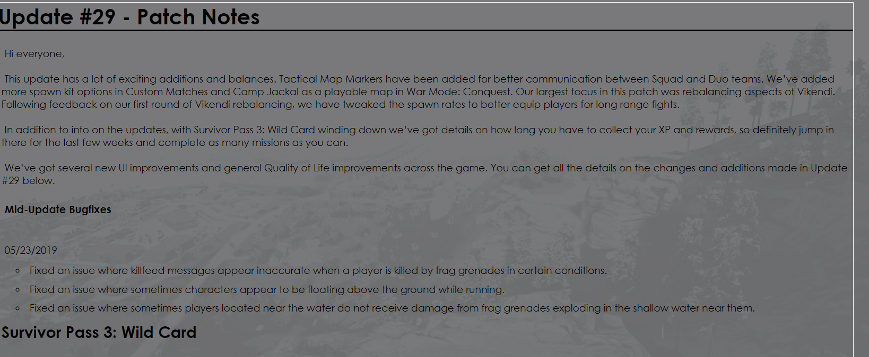
02
PLAYERUNKNOWN’S BATTLEGROUNDS
Composition
Design & Features
Source Code - js
Source Code - css
Source Code - html
Slide effect - JQuary
$(document).ready(function()
{
$("#flip").click(function()
{
$("#panel").slideToggle("slow");
}
);
}
);
//if id="flip" is clicked
//slide toggle id="panel"
Copyright ⓒ Slug. All right reserved.

Slide 10
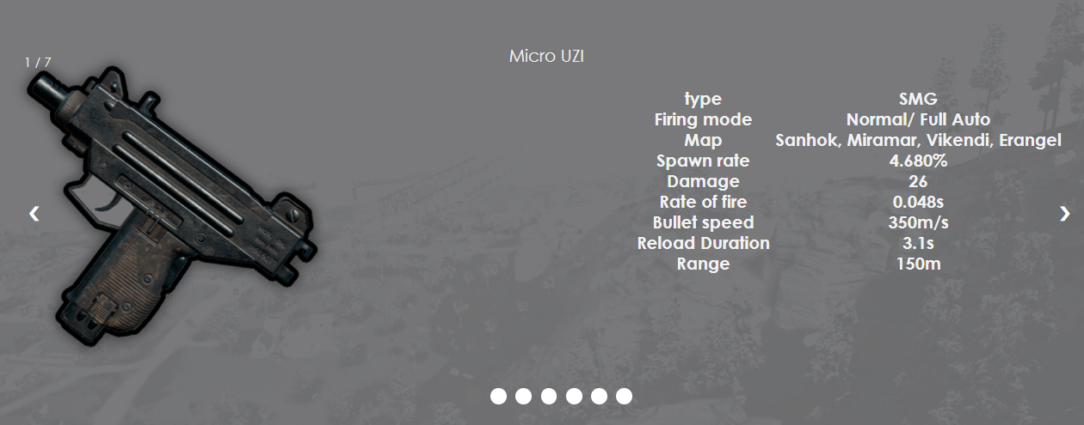
02
PLAYERUNKNOWN’S BATTLEGROUNDS
Composition
Design & Features
Source Code - js
Source Code - css
Source Code - html
Image Slide – Java Script Basic algorithm
function showSlides(n) {
var i;
var slides = document.getElementsByClassName("mySlides");
var dots = document.getElementsByClassName("dot");
if (n > slides.length) {slideIndex = 1}
if (n < 1) {slideIndex = slides.length}
for (i = 0; i < slides.length; i++) {
slides[i].style.display = "none";
}
for (i = 0; i < dots.length; i++) {
dots[i].className = dots[i].className.replace(" active", "");
}
slides[slideIndex-1].style.display = "block";
dots[slideIndex-1].className += " active";
}
var slideIndex = 1;
showSlides(slideIndex);
function plusSlides(n) {
showSlides(slideIndex += n);
}
function currentSlide(n) {
showSlides(slideIndex = n);
}
Copyright ⓒ Slug. All right reserved.

Slide 11

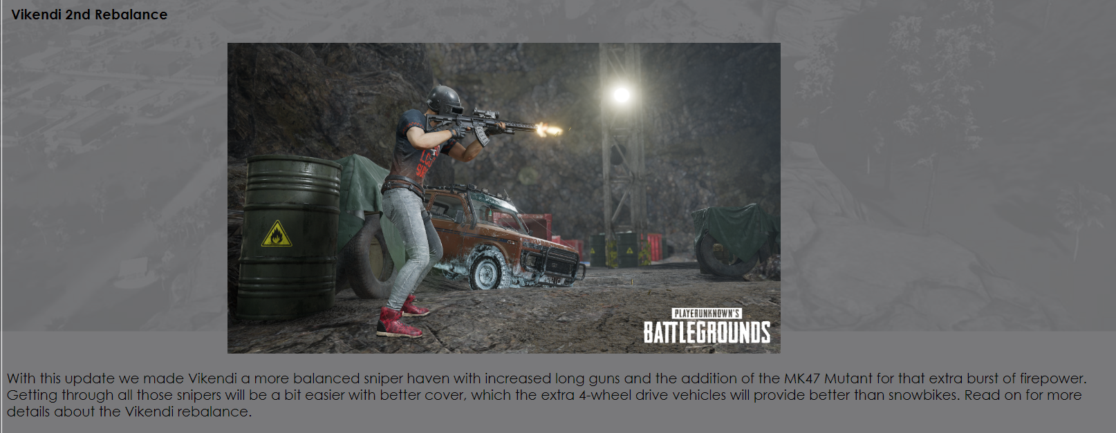
02
PLAYERUNKNOWN’S BATTLEGROUNDS
Composition
Design & Features
Source Code - js
Source Code - css
Source Code - html
CSS
background-image:linear-gradient(rgba(0,0,0,0.8),rgba(0,0,0,0.8)),url(../img/battleground_main.jpg);
Transparency is set to 0.8
ul is floats
li inside ul is inline-block
li inside ul has no decoration+ and transition is on to make effect
When hovers or is in active the color changes to #fff
To make the image in center, put the <img>tag in between text tag that has text-align: center.
Copyright ⓒ Slug. All right reserved.

Slide 12
03
Starcraft
About the Starcraft Website
Website Design
Code

Slide 13
03
Starcraft
About the Starcraft Website
1
2
3
4
Introduction of Starcraft
Background and Genre of Starcraft
How to play Starcraft
Video & Screenshot
Introduction of Starcraft
Website’s main screen
Background of game, genre of game
You can learn how to play Starcraft.
You can see Starcraft official trailer, Playthrough and high quality screenshots.

Slide 14
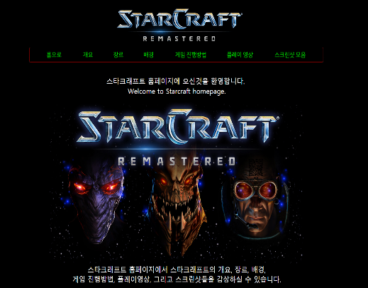
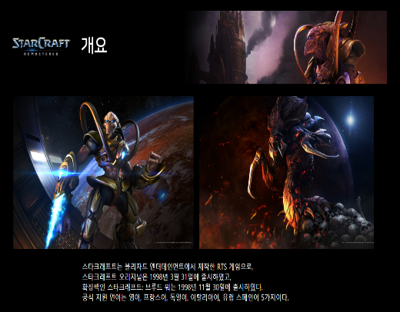
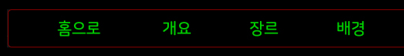
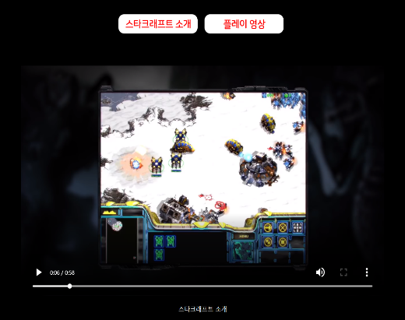
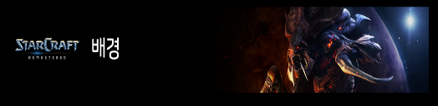
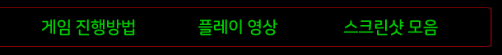
03
Starcraft
Website Design
This is main home screen. The background color is almost black. If you click the logo of top, you can return to the home screen.
Explanation of each section with image.
You can easily move to the section by using the navigation bar.
I added a visual effect by inserting image in the title part.
I divided the sections so you can watch each videos.

Slide 15
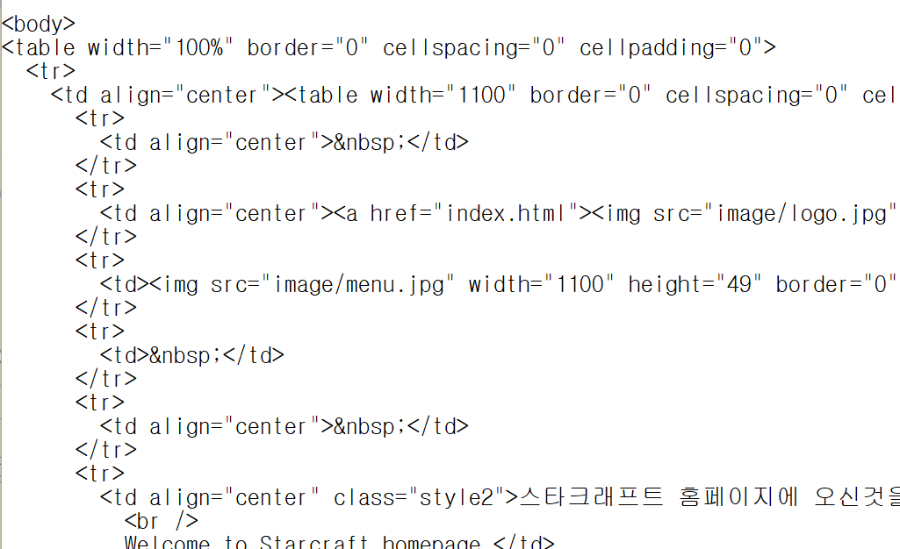
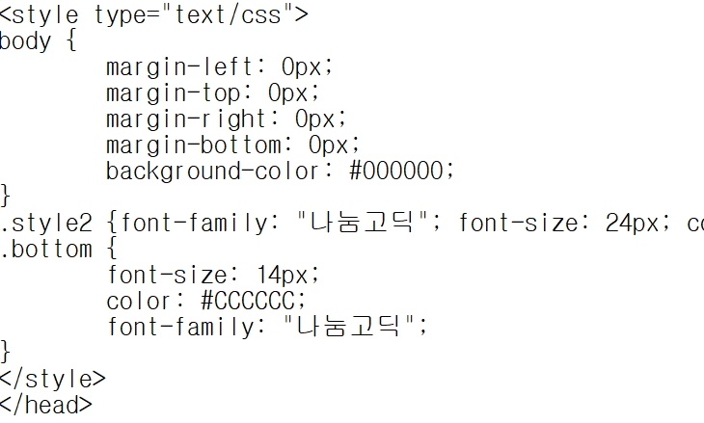
03
Starcraft
Code
text
HTML
video
image
Navigation bars
Font-style
CSS
Font-size
Font-color
Background color

Slide 16
04
League of Legends
Website Composition
Information in Website
What code was used to make contents
Website Design

Slide 17
04
League of Legends
Website Composition
Example Medias
League Homepage
Home
Introduction
About
Home
Introduction
About
Introduction to what this site is about with brief explanation of what League of Legends is.
Introduction to the game, League of Legends. The Home tab covers information regarding information about League other than its gameplay.
In-depth guide about League of Legends as a game. This tab explains about League of Legends gameplay in detail.
Example Medias
League Homepage
Extra medias the visitor of the website may visit. Includes videos and links to external sites.
Official League of Legends homepage link for anyone interested in playing the game or visiting the site for spectating.

Slide 18

04
League of Legends
Information in Website
Home
Information
About
Example Medias
Brief information about League of Legends excluding the information about League of Legends gameplay. Miscellaneous information about game’s statistics and such are included.
Simplified information about League of Legends gameplay. The bare basics and objectives of the game are laid out.
In-depth information about gameplay. No advanced information are included but this tab covers most basic facts about this game required to play a game.
Medias other than the game itself. Links and information on League of Legends comic, league of legends website, and official Youtube channel.

Slide 19
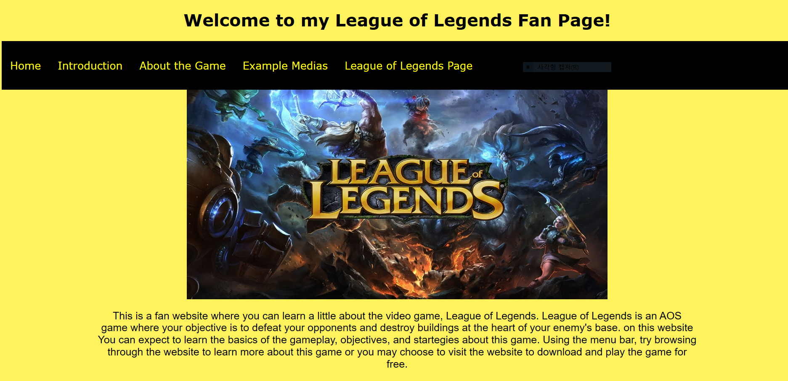
04
League of Legends
What code was used to make contents
HTML
HTML was used to write the texts of this website and place video/images. The HTML served as skeletal structure in making of League of Legends Website.
CSS
CSS was used to format the font style of website. It was also used to format navigation bar and image gallery. After making class for the style of website contents, each contents were assigned class value.
JavaScript
JavaScript was used to make slideshows on About League of Legends and Gameplay tab. Terminologies referring to the contents of the game have visual aid in the form of a slideshow.

Slide 20
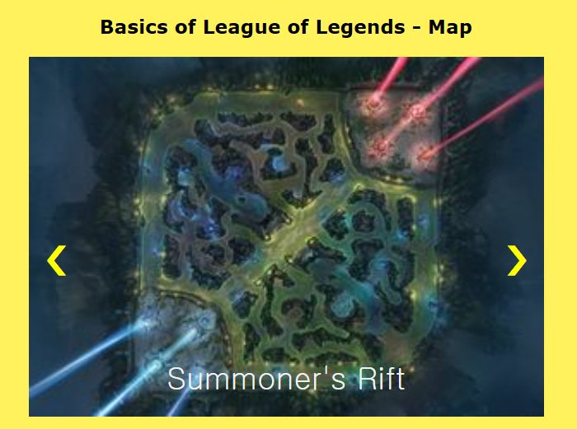
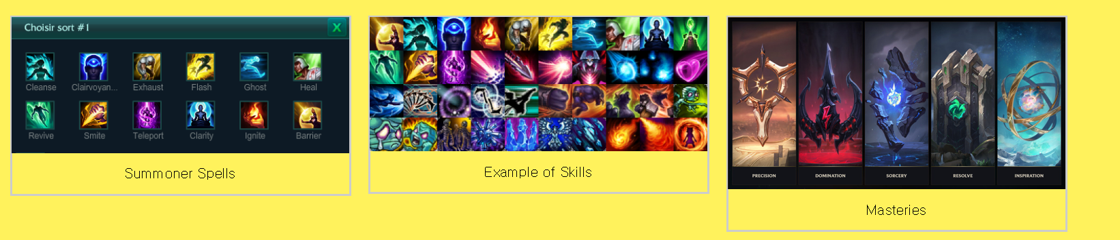
04
League of Legends
Website Design
League of Legends Theme
Slideshows
League of Legends have a thematic color scheme of yellow, black, and blue. The website used font color, background color, and images that match the color theme of League.
On sections that include information about terminologies of League, Slideshows containing images are present to provide visual aids.
Image Galleries
Navigation Bar
Image galleries were provided for visual aid if there are too many images to show on slideshow. Galleries containing all images to be shown are present in such cases.
Navigation bar is at the top of every link to allow navigating within the website easier.
HR tags
<hr></hr> tags were used to add thematic breaks everytime a new topic was to be explained

Slide 21
THANK YOU
Slug’s free template
Copyright ⓒ Slug. All right reserved.

